Slide 1

Nykaa Healthcare Products Analysis
By:Nagamuni Latha
Leena Varma
Nanda Varshitha
Naveen
Date: July 2025

Slide 2

Introduction
Nykaa is one of India's leading e-commerce platforms for beauty and healthcare products
This project focuses on analyzing healthcare product listings on Nykaa to uncover pricing trends, discounts, ratings, and customer preferences.

Slide 3
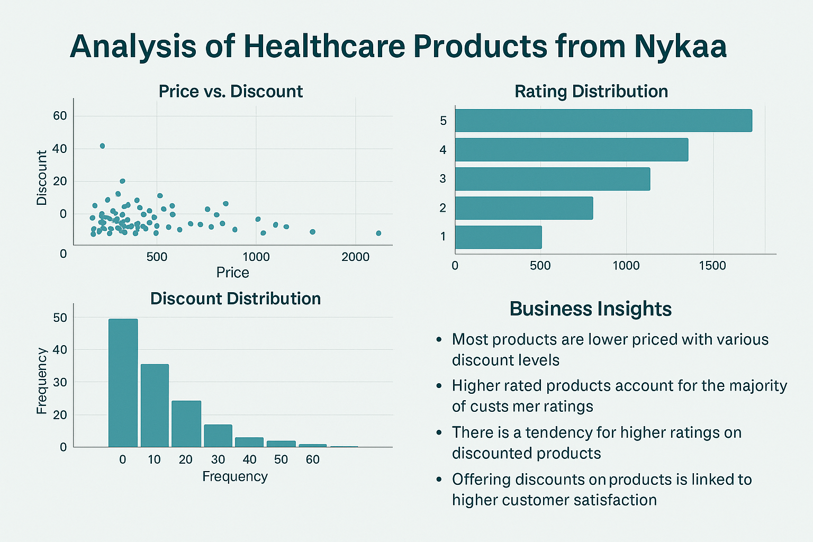
Objective
Extract and analyze healthcare product data from Nykaa.
Visualize pricing, discounts, and rating distributions.
Derive business insights from customer ratings and discount strategies.
Identify relationships between price, discount, and customer satisfaction.

Slide 4



Data Collection
Website: www.nykaa.com
Category: Healthcare Products
Tools Used: Selenium, BeautifulSoup
Total Products Scraped: ~1000
Pagination Handled: Yes
Data stored in structured format (CSV)

Slide 5
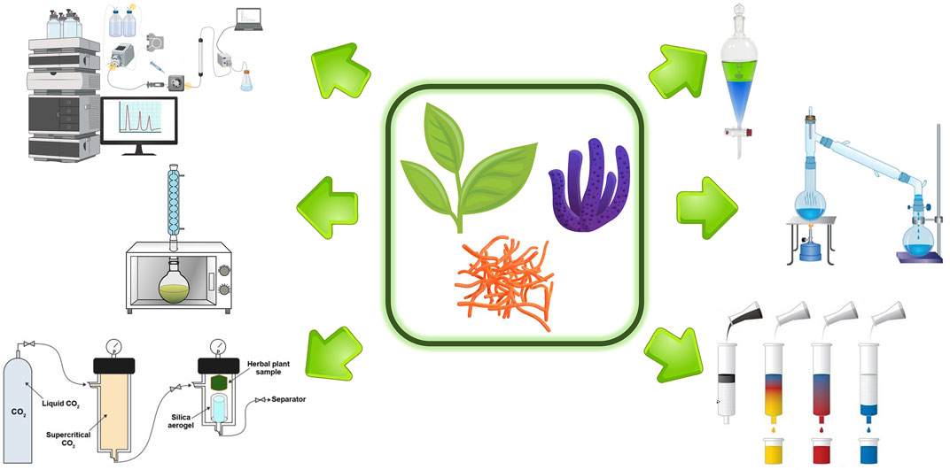
Features (Columns Extracted)
- Product Name - Brand - Original Price - Discount (%) - Discounted Price - Reviews - Ratings

Slide 6

Data Cleaning
Removed duplicates and irrelevant entries
Converted data types (e.g., price to numeric)
Handled missing values (e.g., ratings or discounts)
Cleaned and standardized discount formats

Slide 7

Tools & Libraries
- Python - Selenium & BeautifulSoup (Web Scraping) - Pandas & NumPy (Data Cleaning) - Matplotlib & Seaborn (Visualization) - Jupyter Notebook (EDA Execution)

Slide 8
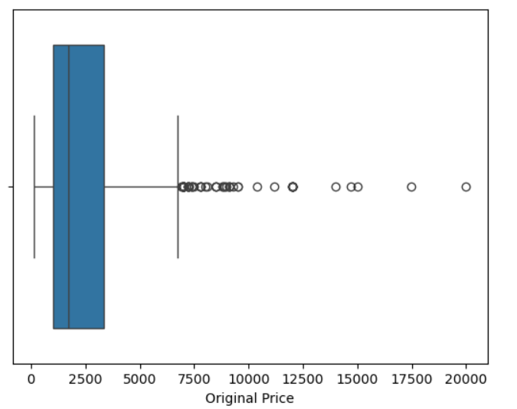
Outliers in Original Prices

Slide 9
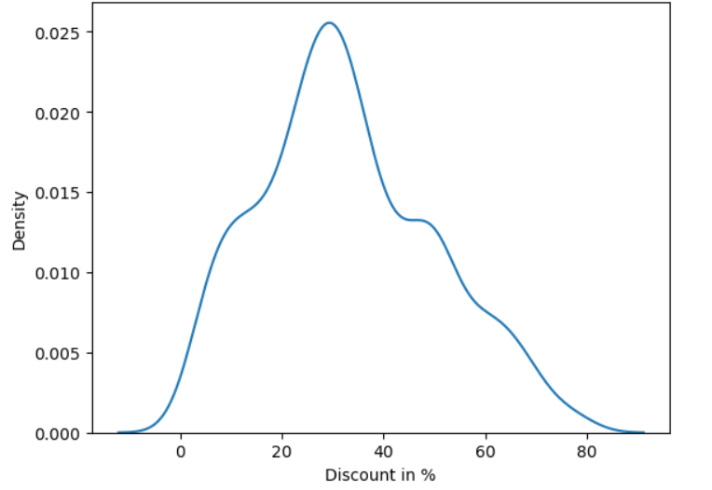
Percentage Discount Across Products

Slide 10
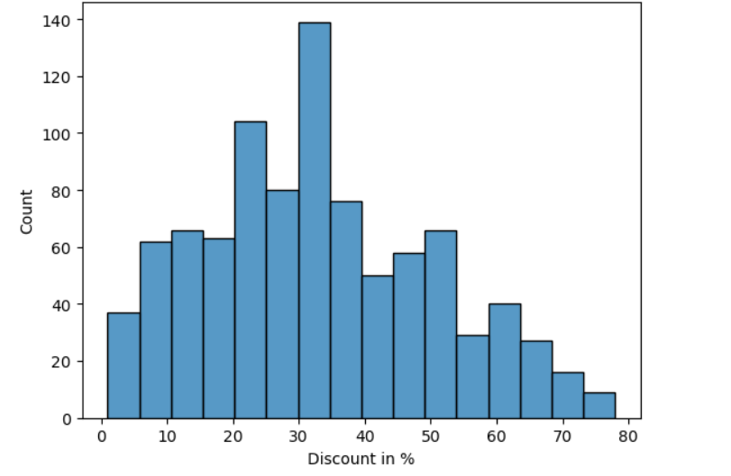
Proportion of Products by Discount % Ranges

Slide 11
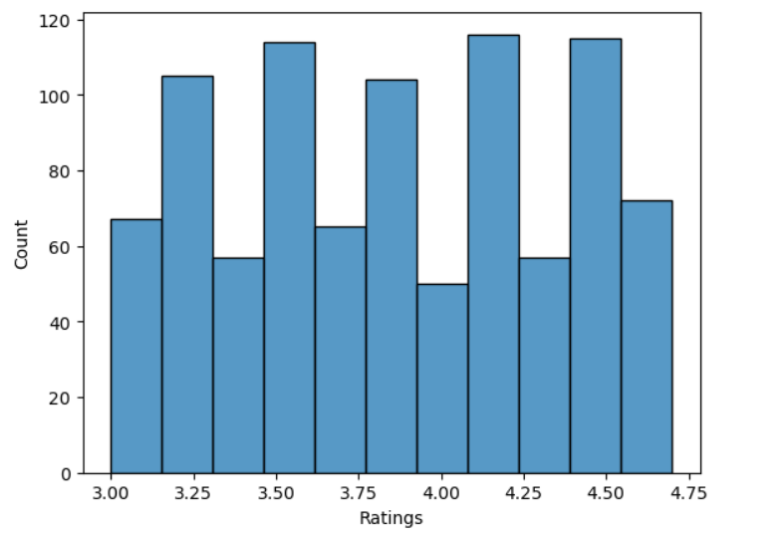
Discount Across Rating Ranges

Slide 12
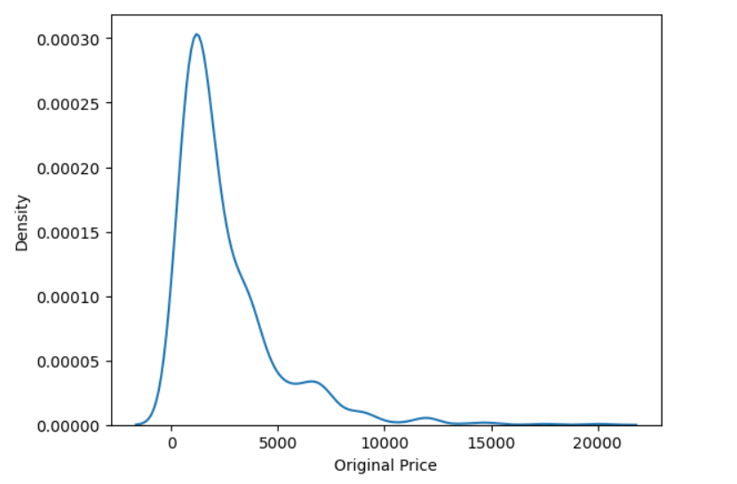
Distribution of Original Prices

Slide 13
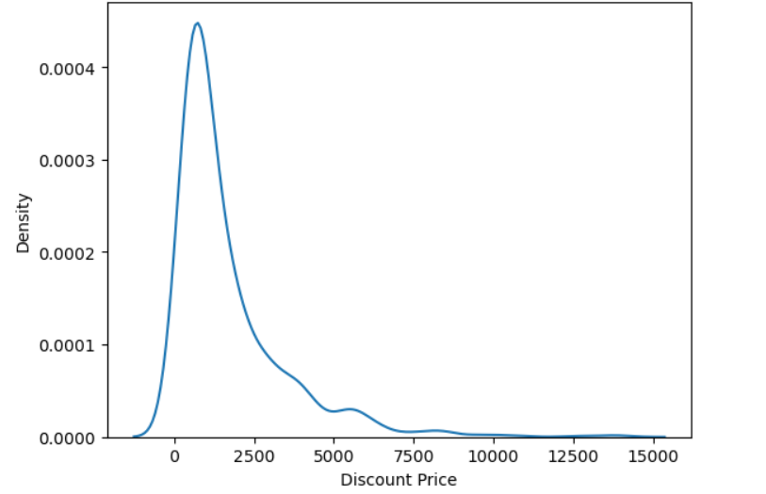
Distribution of Discounted Prices

Slide 14
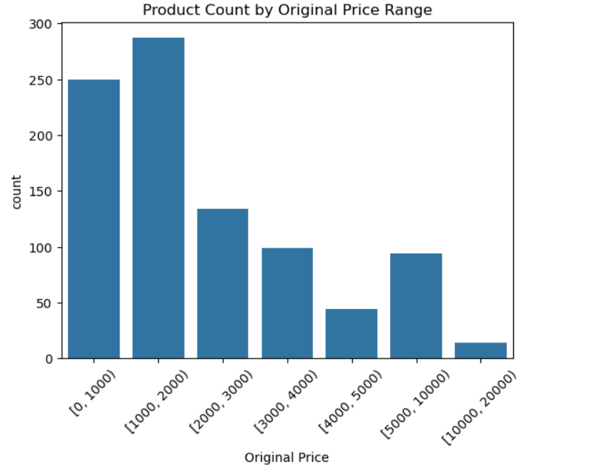
Product Count by Original Price Range

Slide 15
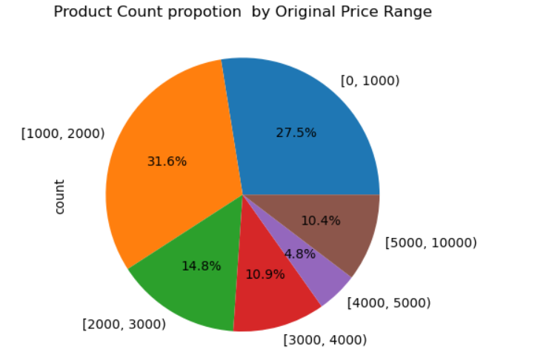
What propotion of Nykaa healthcare products fall into each discounted price range

Slide 16
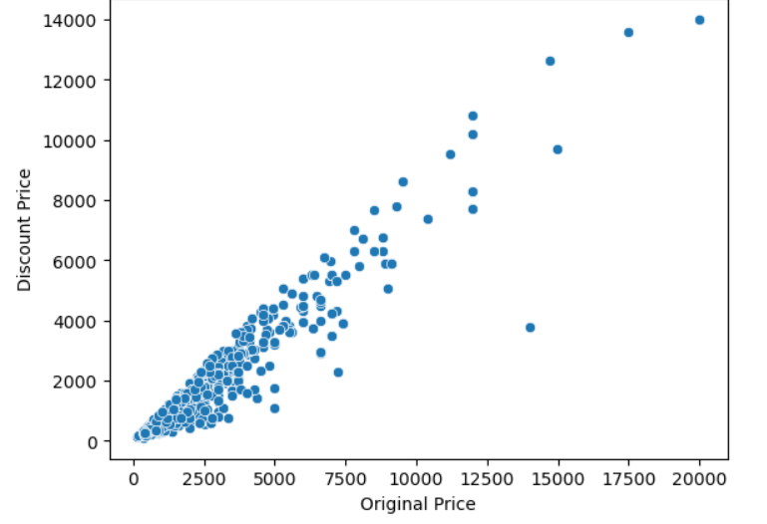
Original vs Discounted Price Relationship

Slide 17
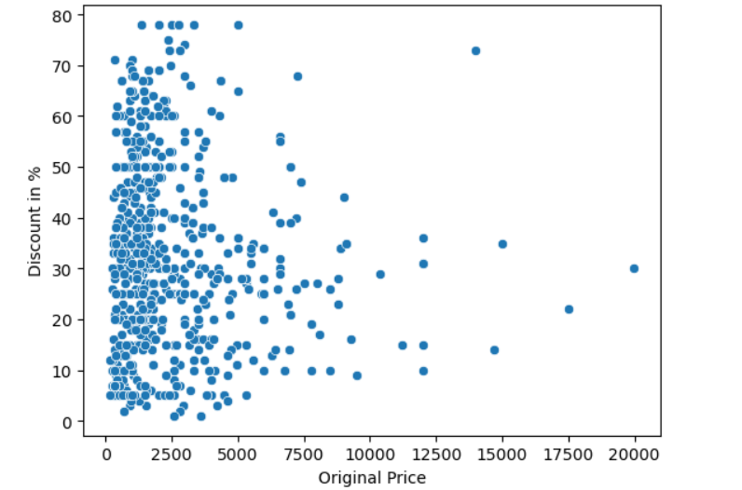
Are higher-priced products given bigger discounts?

Slide 18
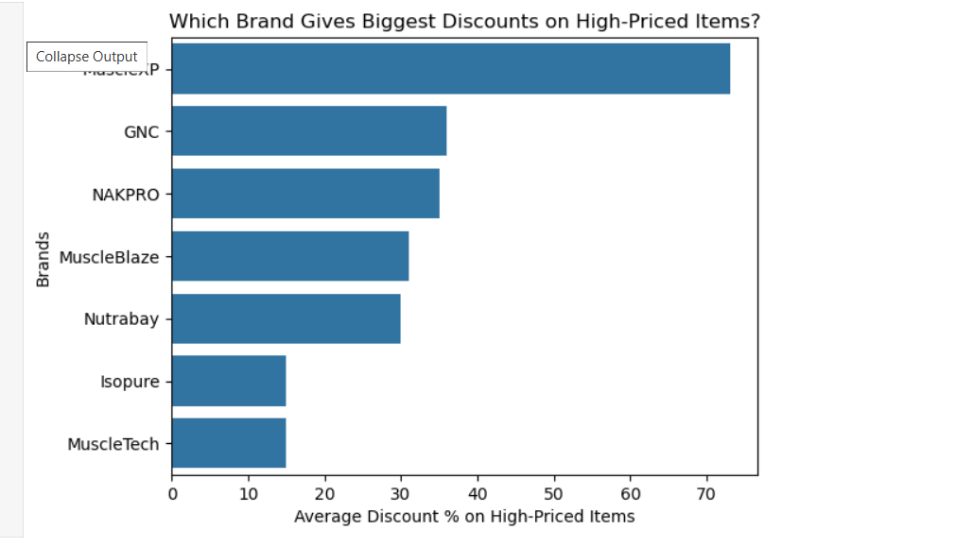
Which brand gives the biggest discounts on high-priced items

Slide 19
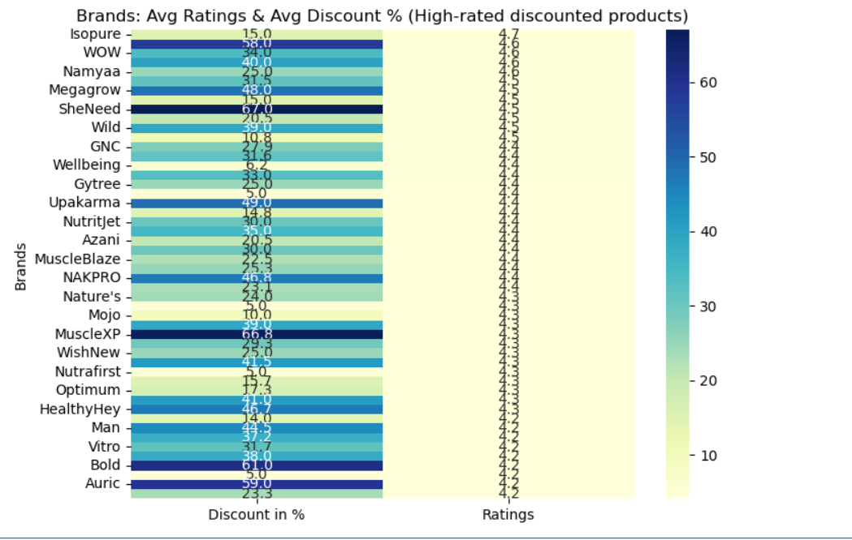
Which brand’s discounted products are also highly rated?

Slide 20

Key Insights
Majority of products are priced under ₹5000
Discounts mostly fall between 10% and 30%
Highly rated products tend to receive consistent discounts
Brands like NAKPRO and MuscleBLaze dominate

Slide 21

Challenges
Handling dynamic content using Selenium
Missing or hidden elements
Duplicates from infinite scroll
Parsing inconsistent discount formats

Slide 22

Conclusion
Analyzed 1000+ Nykaa healthcare products
Visualized key metrics like price, discount, and rating
Identified market trends from consumer-facing data

Slide 23


Future Work
Use NLP to analyze review sentiments
Predict product ratings using ML
Expand to skincare and beauty categories

Slide 24
